Slide 1
Semantic analysis. Classification of TripAdvisor’s reviews
Darya Kandalina

Slide 2
Plan of the project
Intro: relevance and purposes
Data description
Exploratory analysis
Model comparison
Results
Future development of the project

Slide 3
Intro
Relevance
Reviews and public evaluation of a particular place is a key factor in its selection. The rating and the text of the review may sometimes not correspond to each other -> it is important to be able to automatically determine the rating based on the text
Purpose
Build a model that predicts a person's rating based on a text review

Slide 4
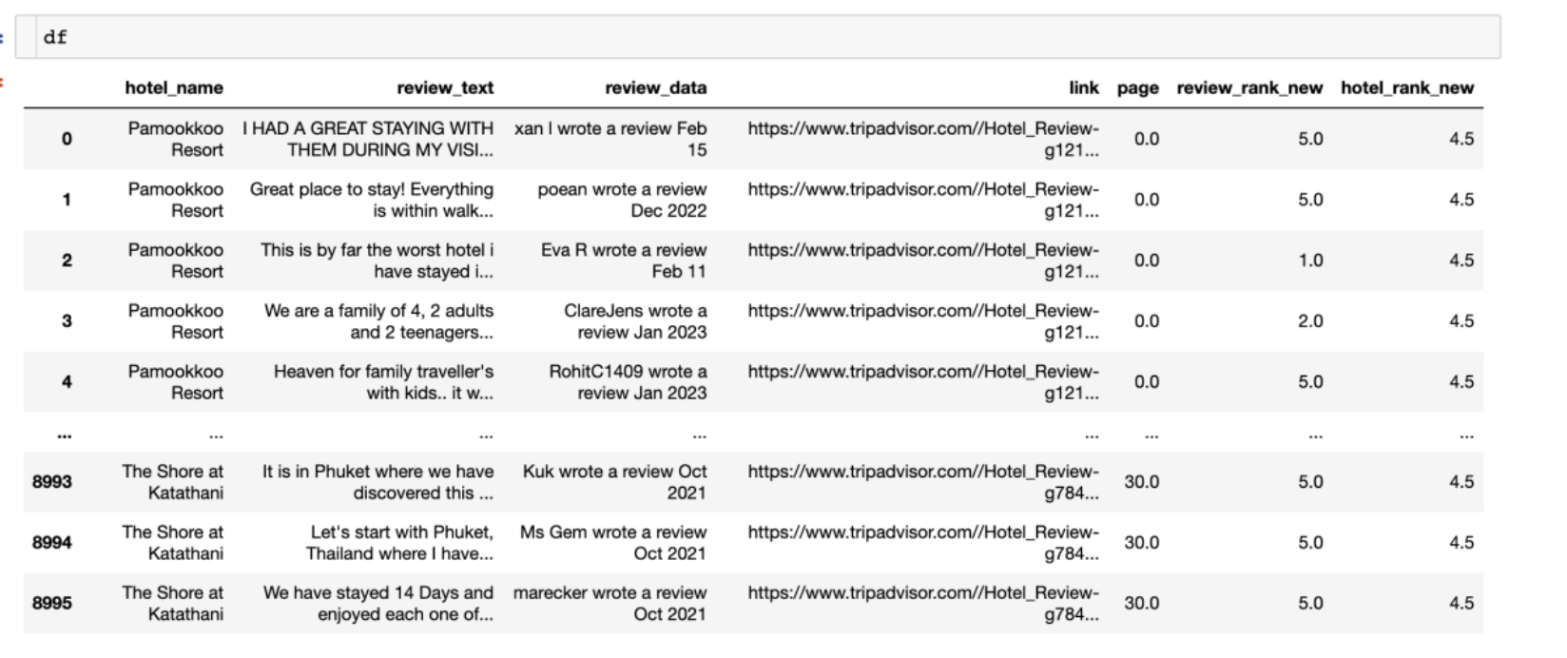
Data description
~9000 observations from TripAdvisor for 60 hotels
Collected info:
- the name of the hotel - review text - date of writing the review - link to review - score from review - the average rating of the hotel on the site

Slide 5
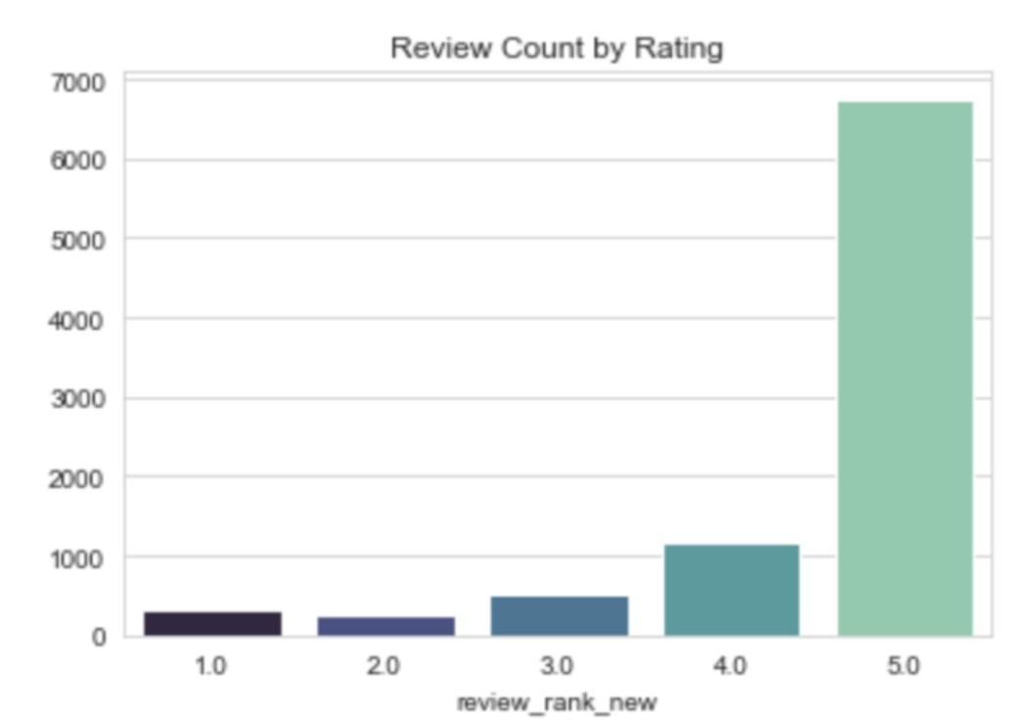
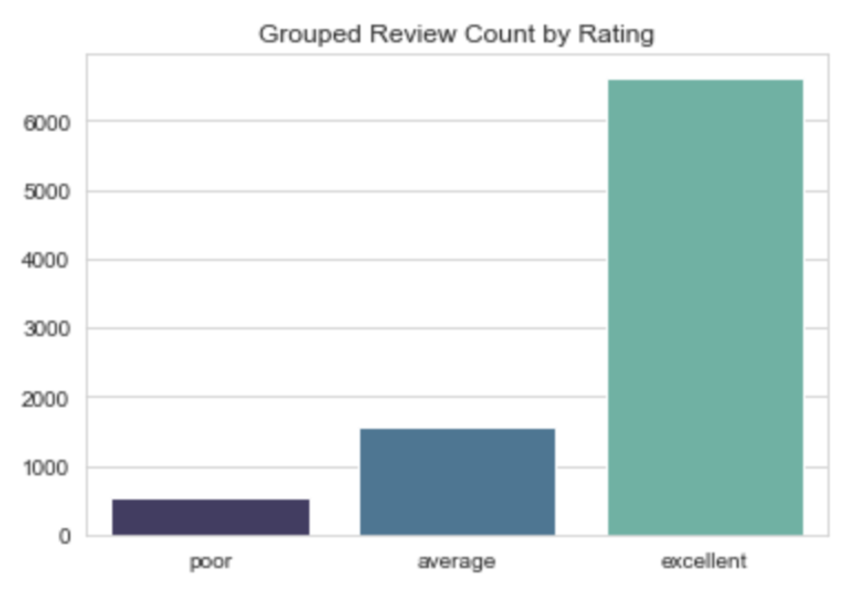
Initial Distribution
Distribution after grouping

Slide 6
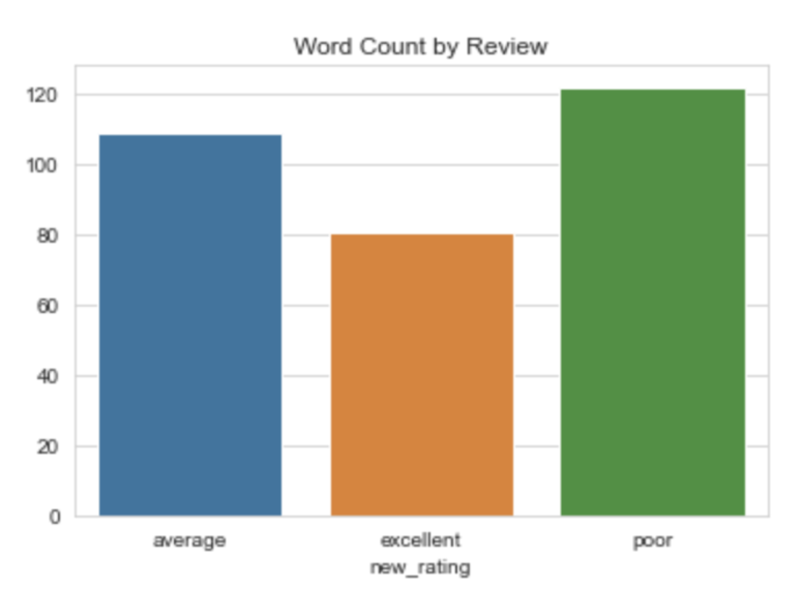
People who write great reviews describe them in less detail than
those who are dissatisfied

Slide 7
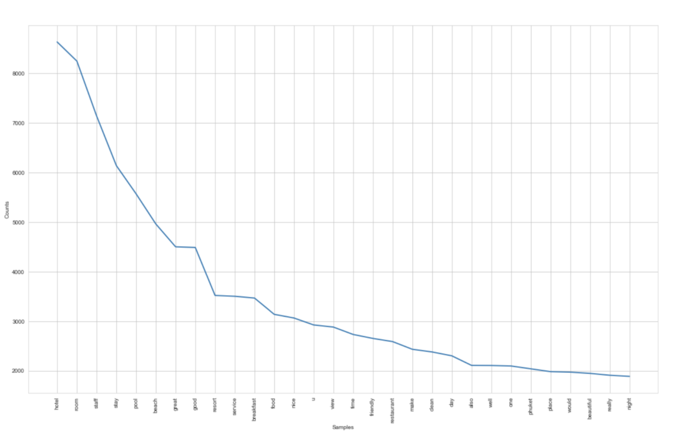
The most "popular" words in reviews
The graph was built after pre-processing reviews: lemmatization, deletion of characters, single case, tokenization

Slide 8
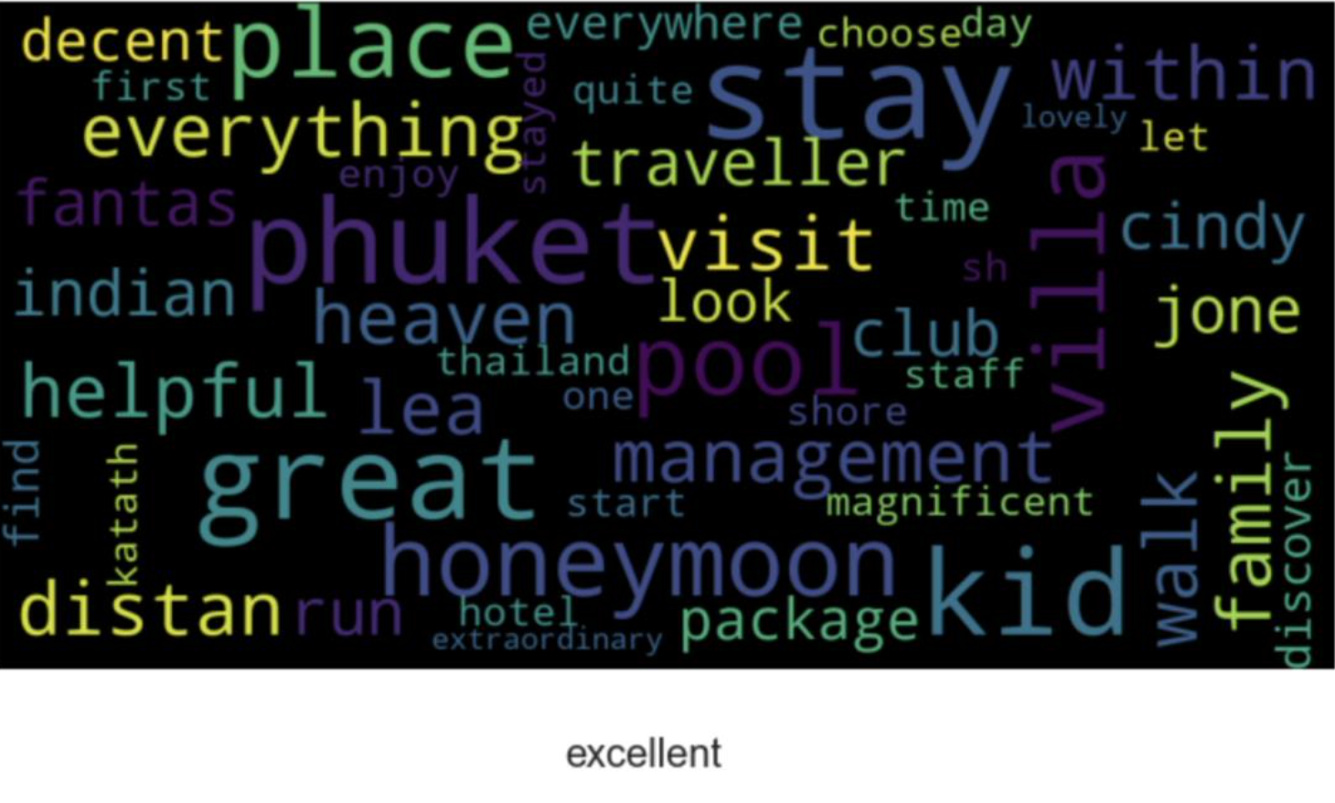
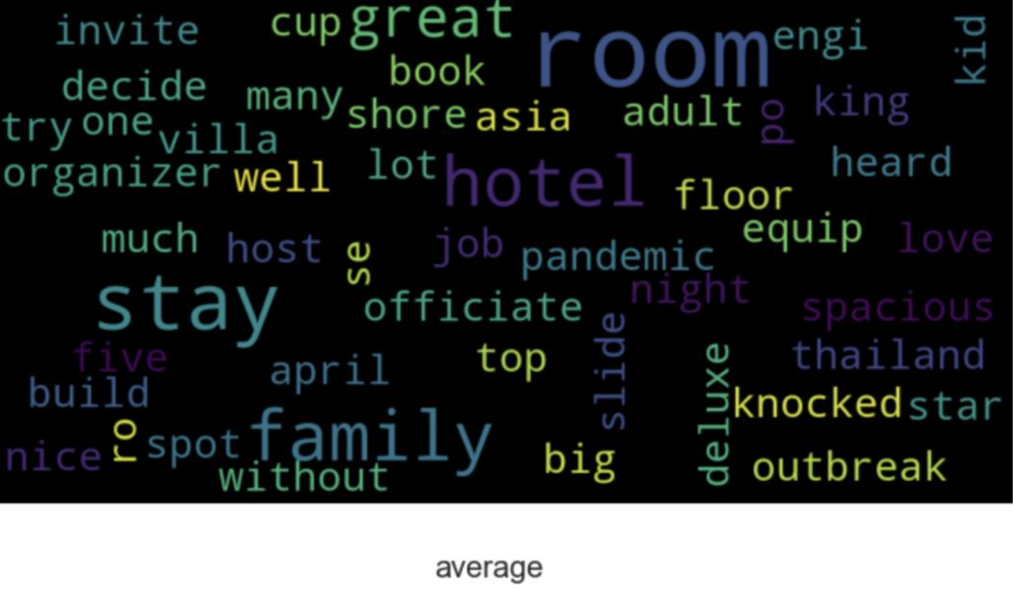
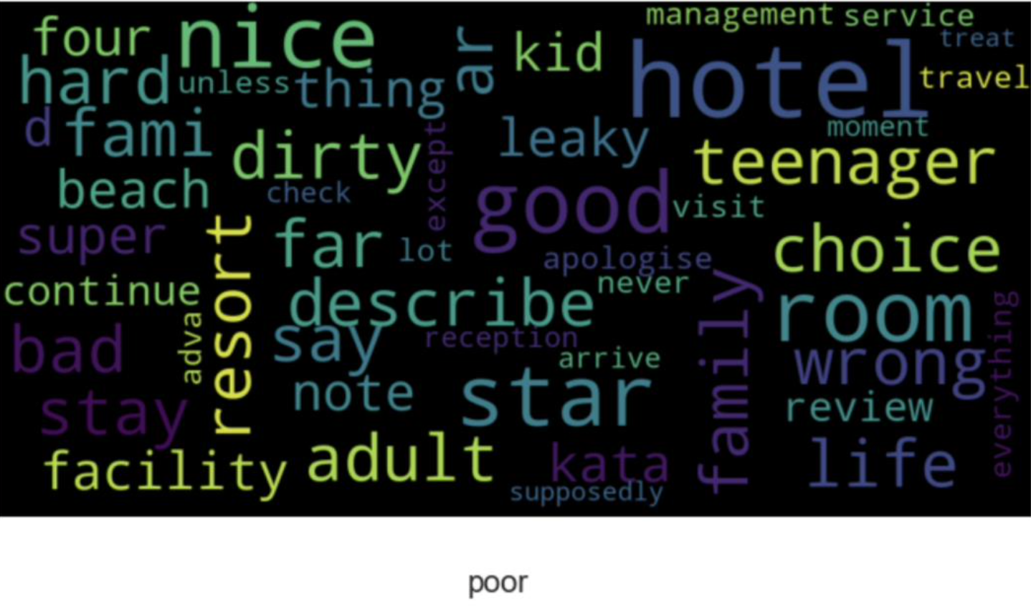
Differences in the frequency of words depending on the class of review

Slide 9
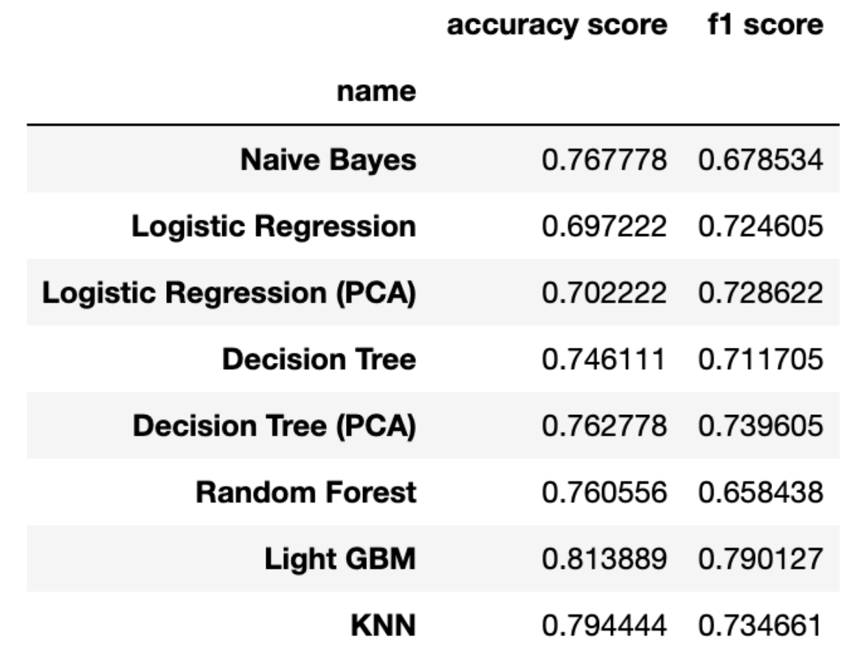
The process of learning and choosing the best model
Metrics on the test set:
TF-IDF + classic ML algorithms
PCA using
Grid – search for the selection
of hyperparameters
Key Metrics: Accuracy, F1-score
Add. Metrics: Precision, Recall

Slide 10
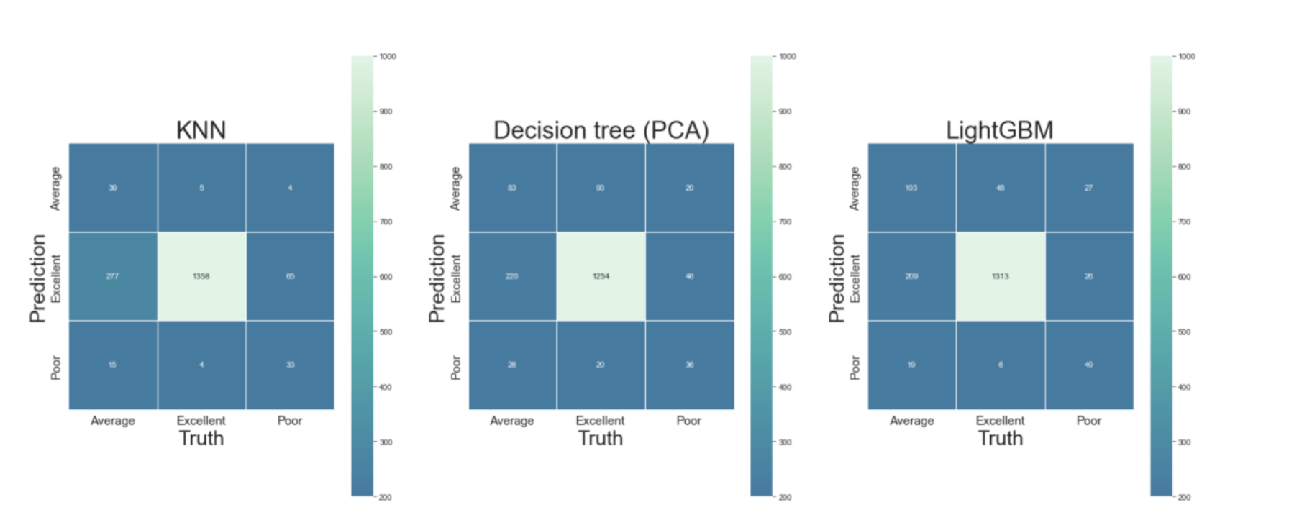
Confusion matrix for best models

Slide 11
Future development of the project
- train the transformer model and compare the results
- explore the relationship with the age of the review on the site and the average rating for the hotel
- apply algorithms that could illustrate the specific points that users complain about

